Slide 1

FANUC ROBOSHOT LINKi
SYSTEM IMPLEMENTATION
ISS HARDWARE AND INFRASTRUCTURE UNIT
INFORMATION SYSTEMS SECTION
OCTOBER 02, 2019

Slide 2
PROJECT OBJECTIVES
Link 2 existing and 2 incoming FANUC machines with a dedicated FANUC server PC that will be running the ROBOSHOT LINKi System.
Data on FANUC server PC must be accessible to both PMI and YEC.

Slide 3
PROJECT CONSTRAINTS
FANUC machines and FANUC server PC must be connected on an isolated network.
Any form of Antivirus/Endpoint Protection on FANUC server PC is not allowed.
FANUC Client PC must be accessible outside the PMI network.

Slide 4
LIST OF EQUIPMENT FOR THE PROJECT
Exchange Rate : $ 1 = Php 52.042
FANUC ROBOSHOT LINKi System
# | Item Description | Qty. | Status | Unit Price in Php | Total Price in Php | Total Price in US $
1 | FANUC 100-ton class | 1 | In Production | - | -
2 | FANUC 50-ton class | 1 | In Production | - | -
3 | FANUC 50-ton class | 2 | For Delivery | - | -
4 | Structured cabling - 6 nodes, 4 nodes to FANUC machines, 1 node to Server PC, 1 node to Server PC SPARE + Data Cabinet + Patch Panel + Labor | 1 | For Purchase | 167,000.00 | 167,000.00 | 3,208.95
5 | Server PC and Client PC - HPE ML30 Gen10 E2124 / 16GB RAM / 1TB HDD / 2 Port Ethernet / 3 Yrs Warranty | 2 | For Purchase | 77,600.00 | 155,200.00 | 2,982.21
6 | Microsoft Windows Server 2019 Standard Core Licenses - 16 pack | 2 | For Purchase | 52,000.00 | 104,000.00 | 1,998.39
7 | Microsoft Windows Server 2019 Remote Desktop Licenses | 20 | For Purchase | 7,400.00 | 148,000.00 | 2,843.86
8 | ESET Endpoint Protection Advanced | 1 | For Purchase | 1,000.00 | 1,000.00 | 19.21
9 | Cisco Catalyst 2960X 24-Port POE Managed switch | 1 | For Purchase | 250,000.00 | 250,000.00 | 4,803.81
 |  |  |  | Total Cost | 825,200.00 | 15,856.43

Slide 5
LIST OF EQUIPMENT FOR THE PROJECT
Exchange Rate : $ 1 = Php 52.042
FANUC ROBOSHOT LINKi System – As of October 31, 2019
# | Item Description | Qty. | Status | Unit Price in Php | Total Price in Php | Total Price in US $
1 | FANUC 100-ton class | 1 | In Production | - | -
2 | FANUC 50-ton class | 1 | In Production | - | -
3 | FANUC 50-ton class | 2 | For Delivery | - | -
4 | Structured cabling - 6 nodes, 4 nodes to FANUC machines, 1 node to Server PC, 1 node to Server PC SPARE + Data Cabinet + Patch Panel + Labor | 1 | For Purchase | 166,072.00 | 166,072.00 | 3,191.11
5 | Server PC and Client PC - HPE ML30 Gen10 E2124 / 16GB RAM / 1TB HDD / 2 Port Ethernet / 3 Yrs Warranty | 2 | For Purchase | 74,000.00 | 148,000.00 | 2,843.86
6 | Microsoft Windows Server 2019 Standard Core Licenses - 16 pack | 2 | For Purchase | 51,500.00 | 103,000.00 | 1,979.17
7 | Microsoft Windows Server 2019 Remote Desktop Licenses | 20 | For Purchase | 7,250.00 | 145,000.00 | 2,786.21
8 | ESET Endpoint Protection Advanced | 1 | For Purchase | 1,000.00 | 1,000.00 | 19.22
9 | Cisco Catalyst 2960X 24-Port POE Managed switch | 1 | For Purchase | 249,724.18 | 249,724.18 | 4,798.51
 |  |  |  | Total Cost | 812,796.18 | 15,618.08

Slide 6
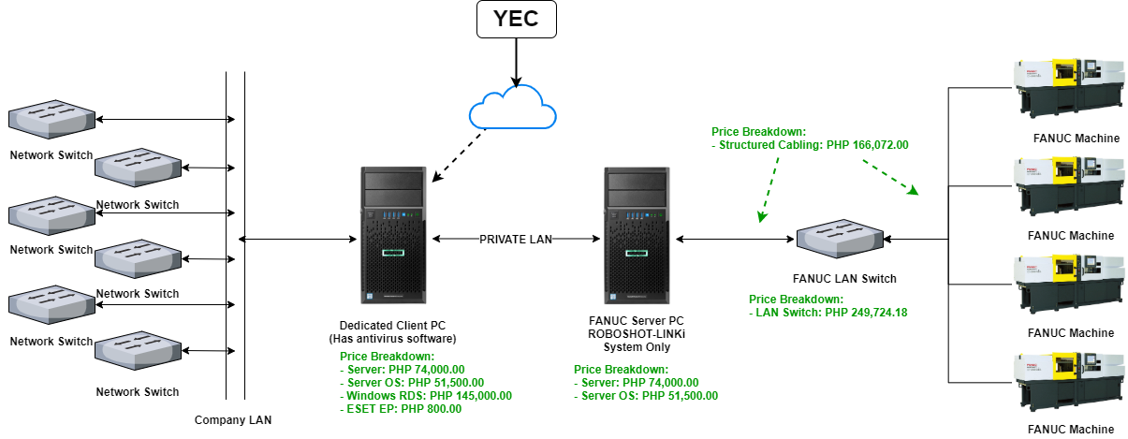
LOGICAL NETWORK DIAGRAM
1,000.00

Slide 7
PROJECT TIMELINE
Timeline | Planned VS Actual | SEPTEMBER 2019 |  |  |  | OCTOBER 2019
 |  | WEEK1 | WEEK2 | WEEK3 | WEEK4 | WEEK1 | WEEK2 | WEEK3 | WEEK4
1. Project Discussion | Planned
 | Actual
2. Planning and Research | Planned
 | Actual
3. Procurement and Deployment | Planned
 | Actual
4. Issue Remediation and Testing | Planned
 | Actual
5. Project Closure | Planned
 | Actual

